Slide 1
TEAM ACTA
Review 2
RedBull Basement Hackathon
29 August 2024

Slide 2
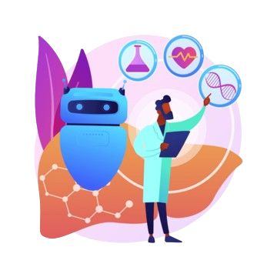
INTRODUCTION
Team Track:
Generative AI
Team Leader:
Virinichi (RA2311050010043)
Team Members:
Aditya Kulshrestha (RA2311033010065)
Arun Krishna Devalala (RA231130010320)
Maneesh Meka (RA2311003011610)
Sanya kapoor (RA2311027010011)

Slide 3
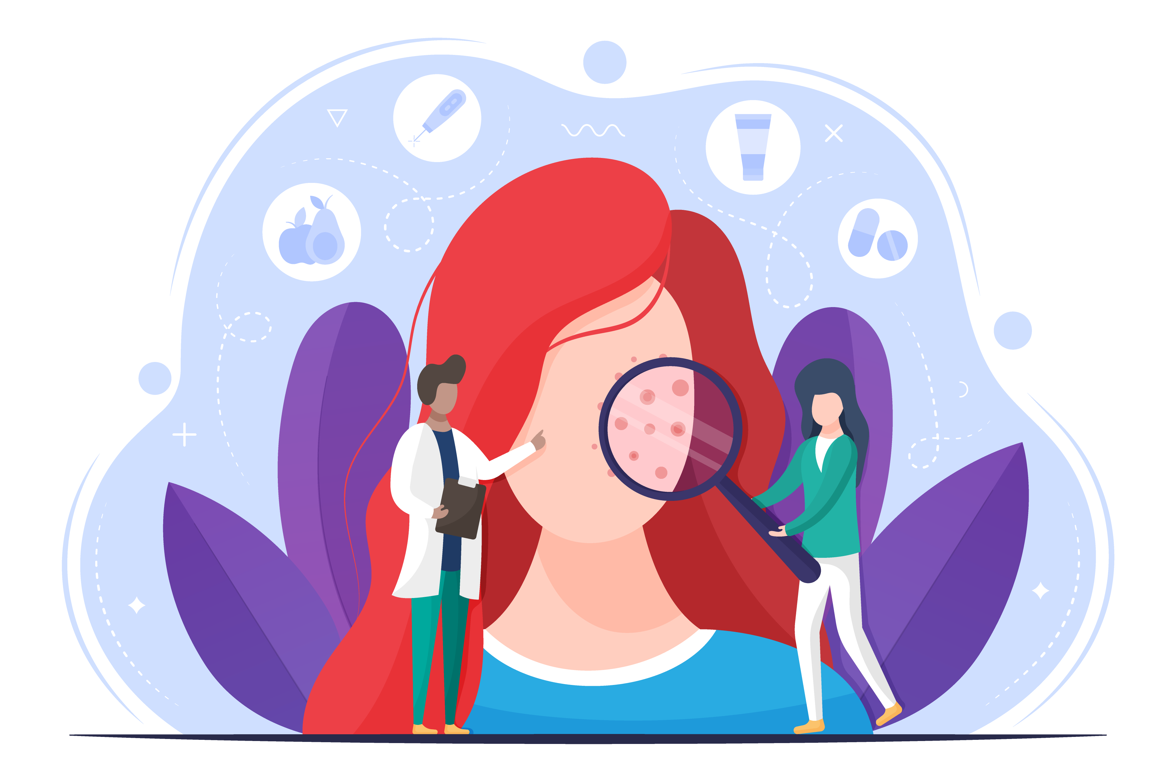
PROBLEM STATEMENT
Gen-AI for Accessible Diagnosis of Skin Conditions

Slide 4
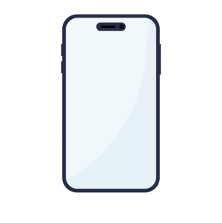
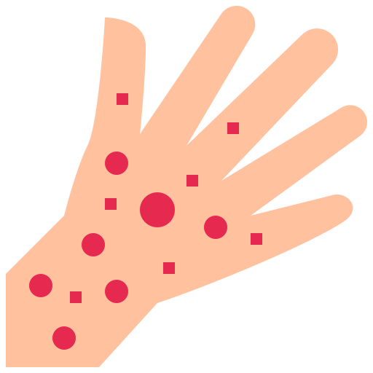
PROPOSED SOLUTION
A mobile app with Google Gemini™ for patients in inaccessible areas to diagnose concerning skin conditions and get an alert to approach medical help. Patient groups also involve persons that find medical professionals intimidating and persons with an aversion to medical care. It also aims to save medical fees of from redundant doctor visits. The app suggests matching conditions, non-interfering treatments and prompts to narrow results. It learns from a history of diagnoses to increase accuracy.

Slide 5
TECHNICAL APPROACH

Slide 6

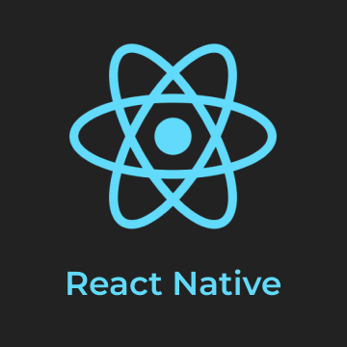

TECH STACK
The Gemini API will be the core of our product. Its Vision API will be used for analysing the skin condition patterns with existing studies.
To increase code reusability, usage of native components and distribute to both iOS and Android users, our mobile app will be developed on React Native.
All backend operations such as user-management and storage of past records will be done serverless-ly via Supabase.

Slide 7

PRIVACY
Our app will feature a prominent disclaimer about our privacy policy during user onboarding. We aim to keep all of the user’s data private and accessible only to the users. Any exchange of data with third-party APIs will go through complete anonymisation.

Slide 8
TARGET AUDIENCE

Slide 9
TARGET AUDIENCE
The initial target audience for our project urban populations
High population cities lead to a high demand for convenient and accessible healthcare solutions.
Despite a greater access to healthcare facilities, the convenience of an initial self-assessment through an app can help people in their busy schedules.
Urban areas have higher levels of smartphone usage, making it more likely that the target audience will have the necessary devices and be comfortable using a mobile app for healthcare-related purposes.

Slide 10
FEASIBILITY AND SCALABILITY
The app will focus on scaling via awareness campaigns in association with private and government healthcare providers.
We aim for a non-profit model with donations from government agencies and other interested parties.
Another stream of revenue can be a small fee for a second, deeper level of analysis for financially-resourceful users.

Slide 11
IMPACT
The app improves early detection of diseases before they become severe or require further medical attention.
It increases access to healthcare to persons who present hesitancy to visit a doctor for minor concerns
The app can provide personalised healthcare advice based on the users skin type and condition

Slide 12
THANK YOU
Please keep this slide for attribution.

